Slide 1

GPT-4
Technical Report
by OpenAI
presented by Micha Nowak

Slide 2
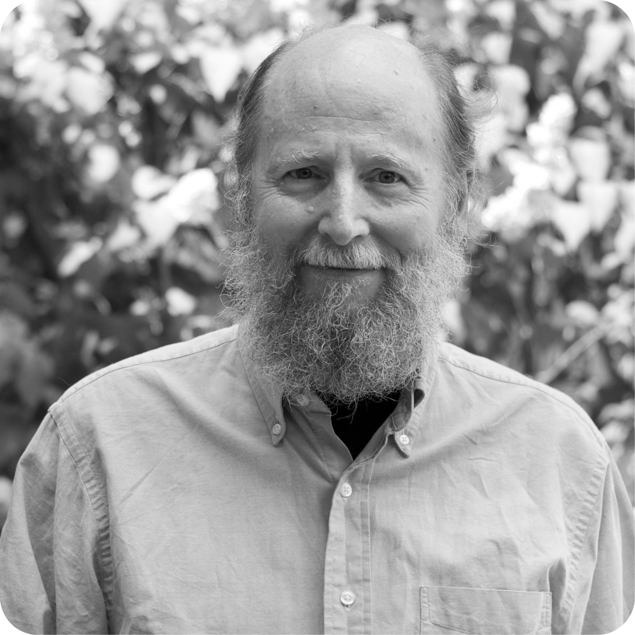
‘The Bitter Lesson of AI’
March 2019
Richard S. Sutton
AI Researcher

Slide 3
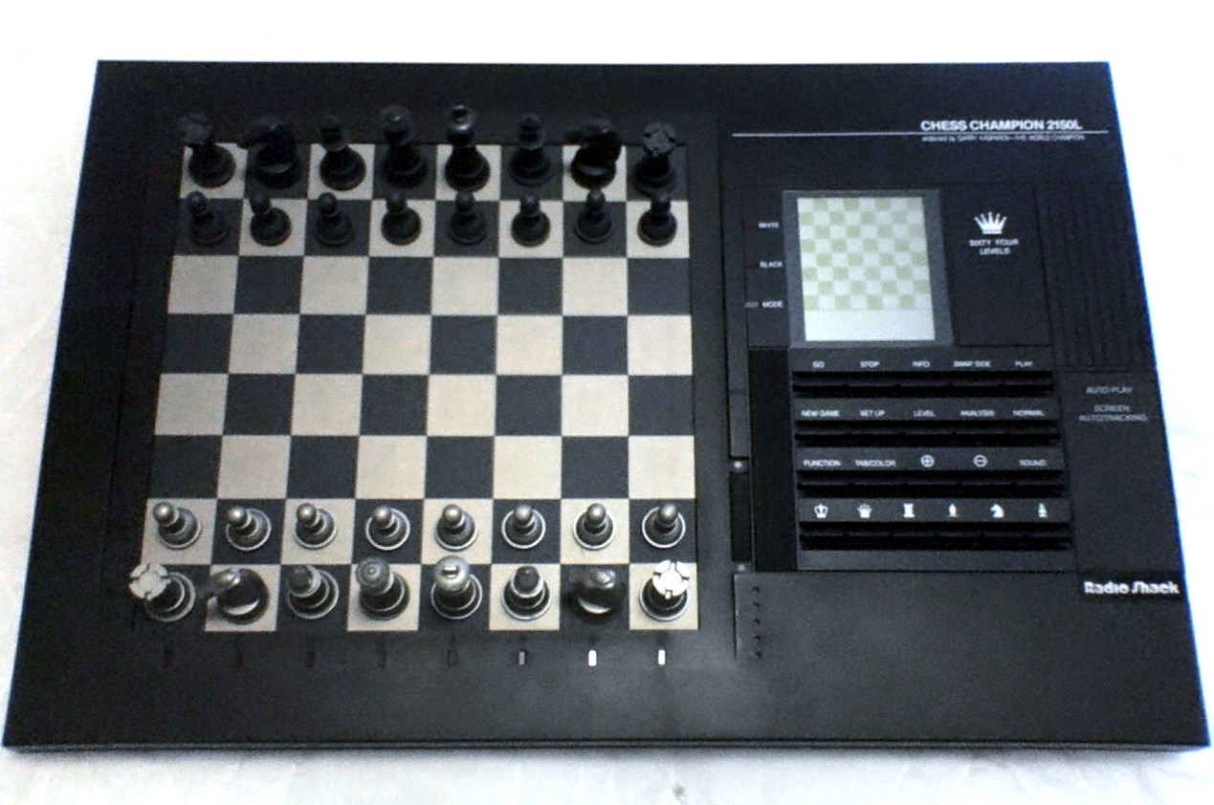
Early Chess engines tried to use human knowledge
→ Failed to beat the best chess players

Slide 4
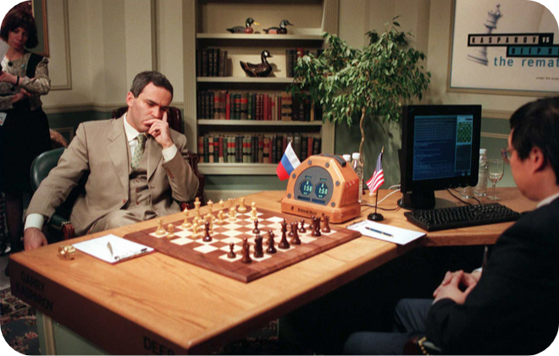
World champion Kasparov, defeated by Deep Blue in 1997
(Simple search-based program on better hardware)

Slide 5
The Bitter Lesson of AI
Handcrafted approaches will be outperformed by simpler, more general approaches leveraging increased compute.
http://www.incompleteideas.net/IncIdeas/BitterLesson.html

Slide 6
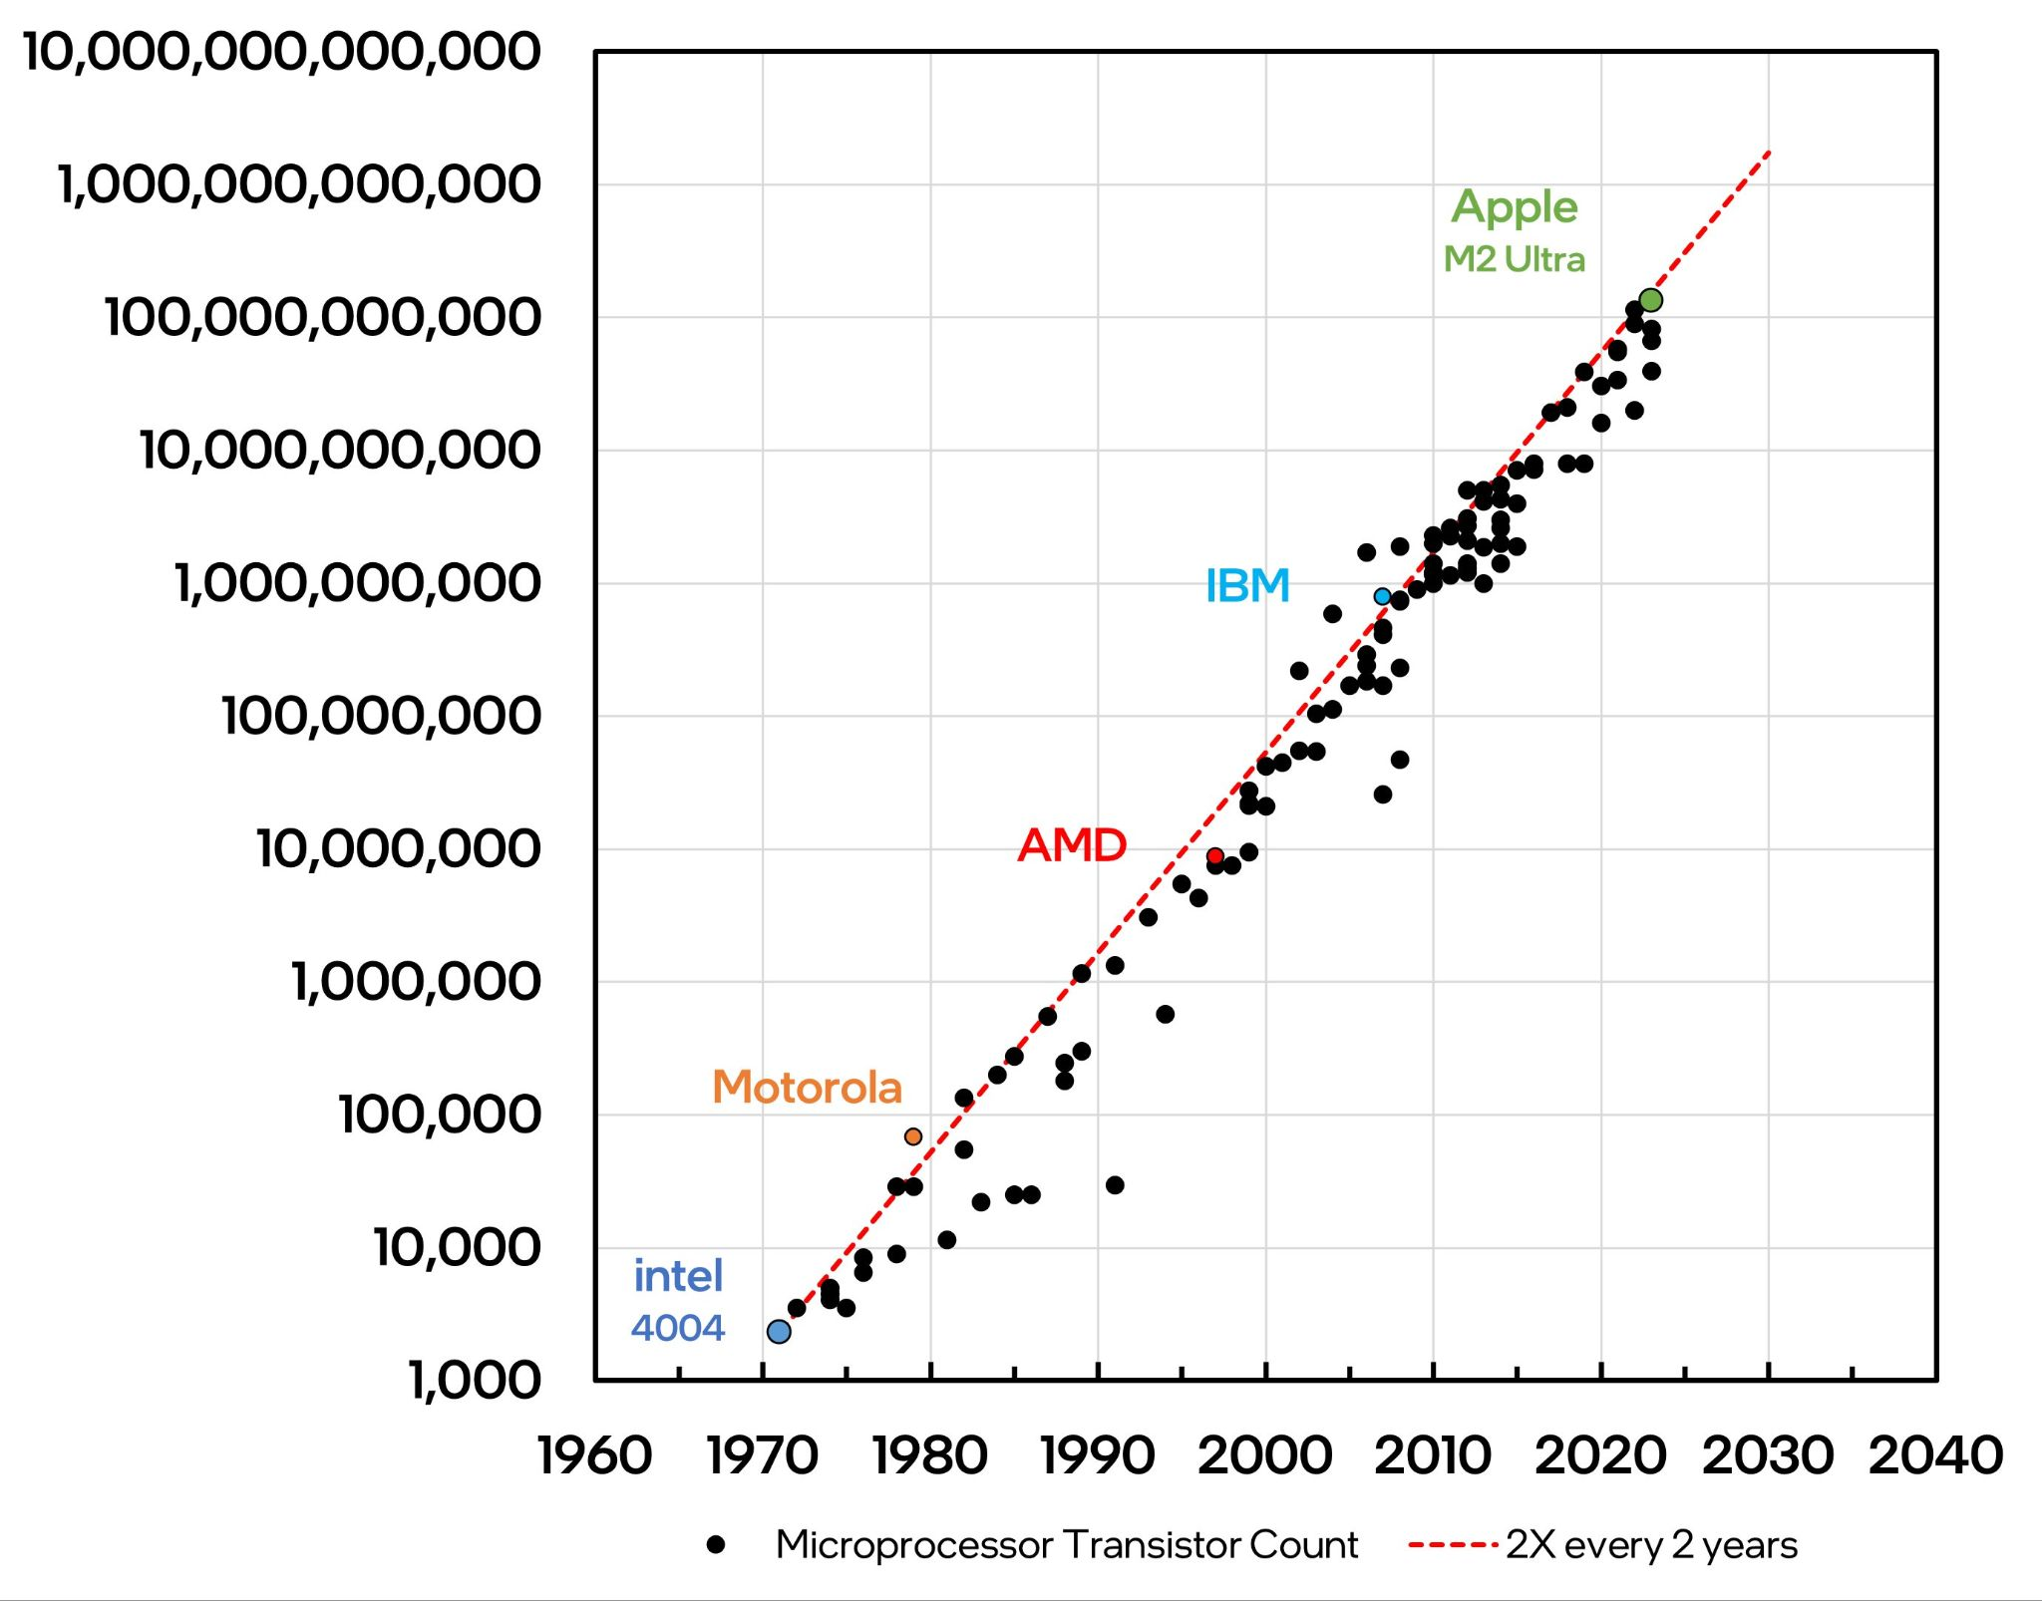
Moores Law: Transistor count doubles ~ every 2 years

Slide 7
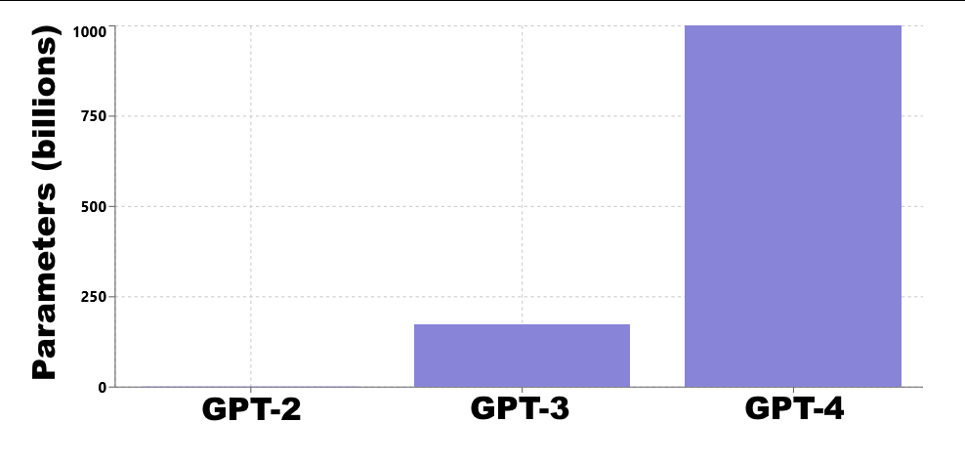
GPT Language Models Parameter Counts

Slide 8
GPT-4
Generative
Pre-Trained
Transformer

Slide 9
GPT-4
Generative
Pre-Trained
Transformer

Slide 10
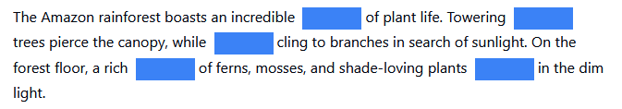
GPT-4
Generative
Pre-Trained
Transformer

Slide 11
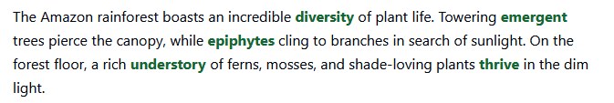
GPT-4
Generative
Pre-Trained
Transformer

Slide 12
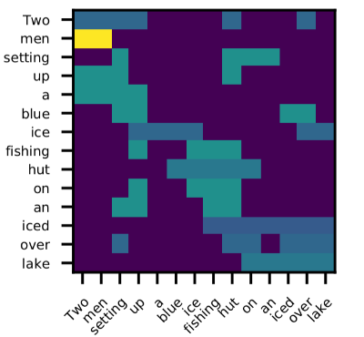
GPT-4
Generative
Pre-Trained
Transformer
Self-Attention Map

Slide 13
What changed from GPT-3 to GPT-4?
Larger model size (175B ~> 1T)
2) Better Performance / Intelligence
Up to 80% higher score on highschool exams
Improved capabilities across 26 languages

Slide 14
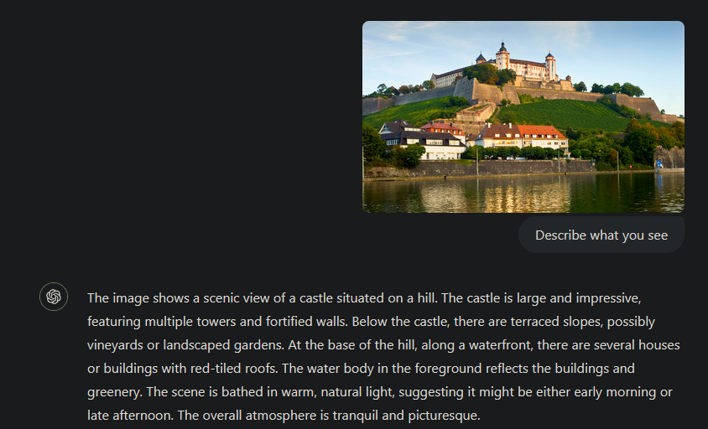
What changed from GPT-3 to GPT-4?
3) Multimodality (Text + Image Input)

Slide 15
Suitability for researching MMIs
• Availability: Paid API Access (~1 ct per request)
• Required ML Knowledge: Low
• CARE Properties: Complementary
• Applicability and Application Medium: Flexible

Slide 16
Suitability for researching MMIs
• Interactivity: Query → Answer
• Fusion: Details not public
Delay depends on:
API Load
Length of Answer

Slide 17
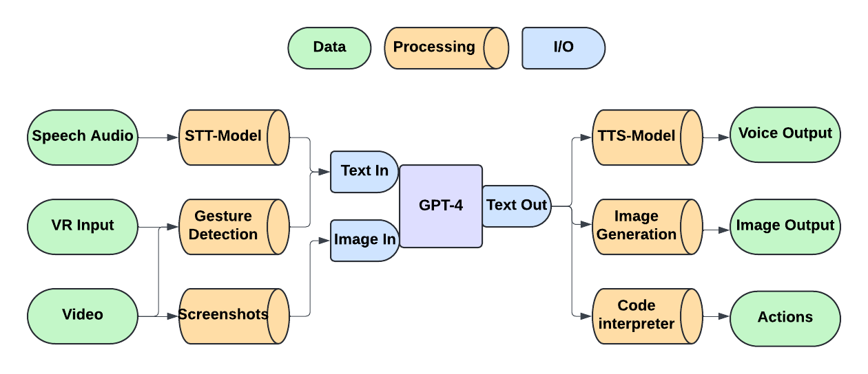
Embedding GPT-4 into a Multimodal Setting

Slide 18
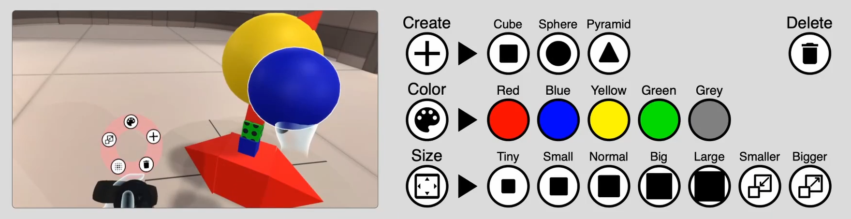
Current MMI systems
Finally on Par?! (Zimmerer et. al. 2020)
https://dl.acm.org/doi/10.1145/3382507.3418850

Slide 19
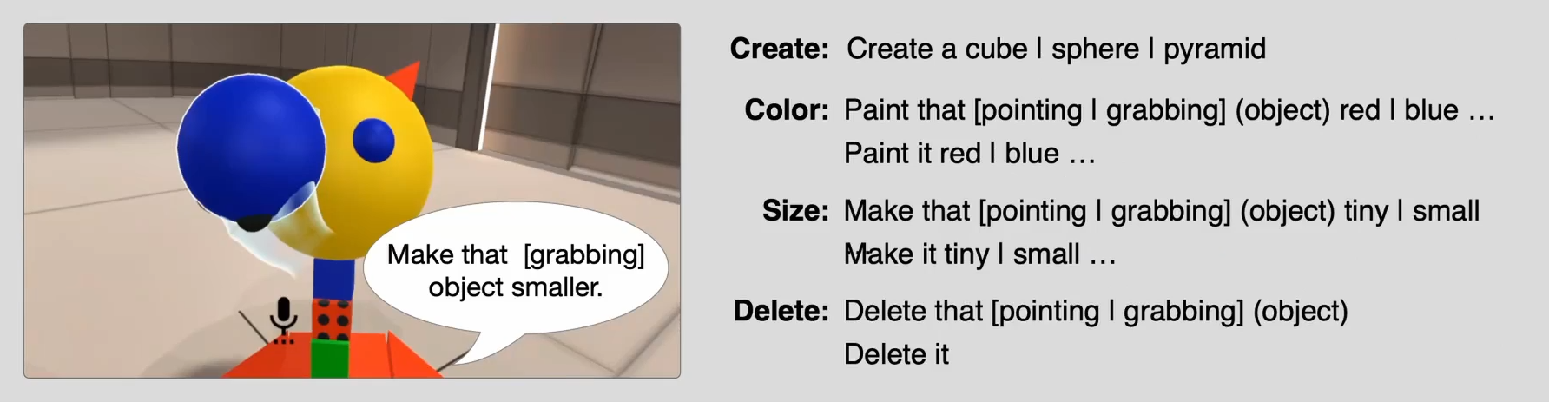
Current MMI systems
Finally on Par?! (Zimmerer et. al. 2020)
https://dl.acm.org/doi/10.1145/3382507.3418850

Slide 20
Limitations of current MMI systems
• Set of actions and commands fixed and pre-defined
“Change the color of the second largest cube to red and make it rotate twice a second”
→ Difficult to implement
“Create a small animated model of the solar system”
→ Impossible to implement if task is not anticipated
My Idea: Use GPT-4’s coding ability to solve this

Slide 21
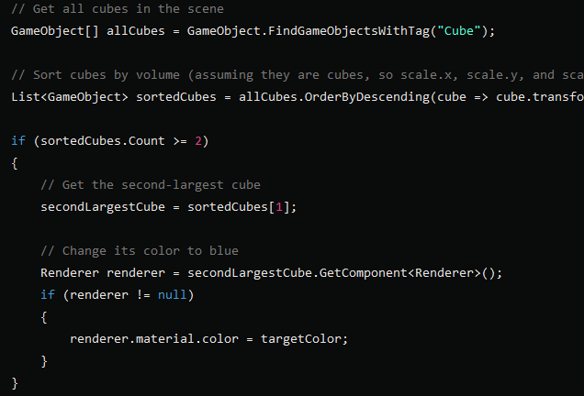
🔊“Change the color of the second largest cube to red and make it rotate twice a second”
GPT-4

Slide 22
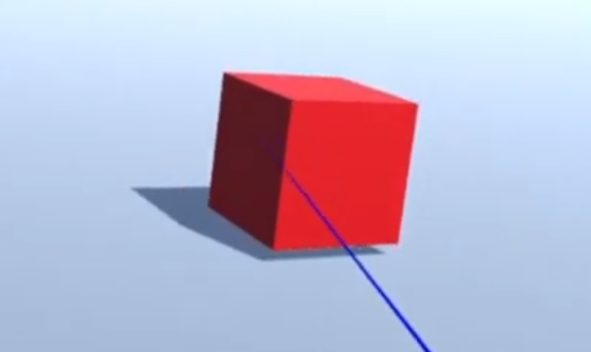
Compile code and inject into running program

Slide 23
Project demo video
▶
(waiting for API answer is fast forwarded for brevity)

Slide 24
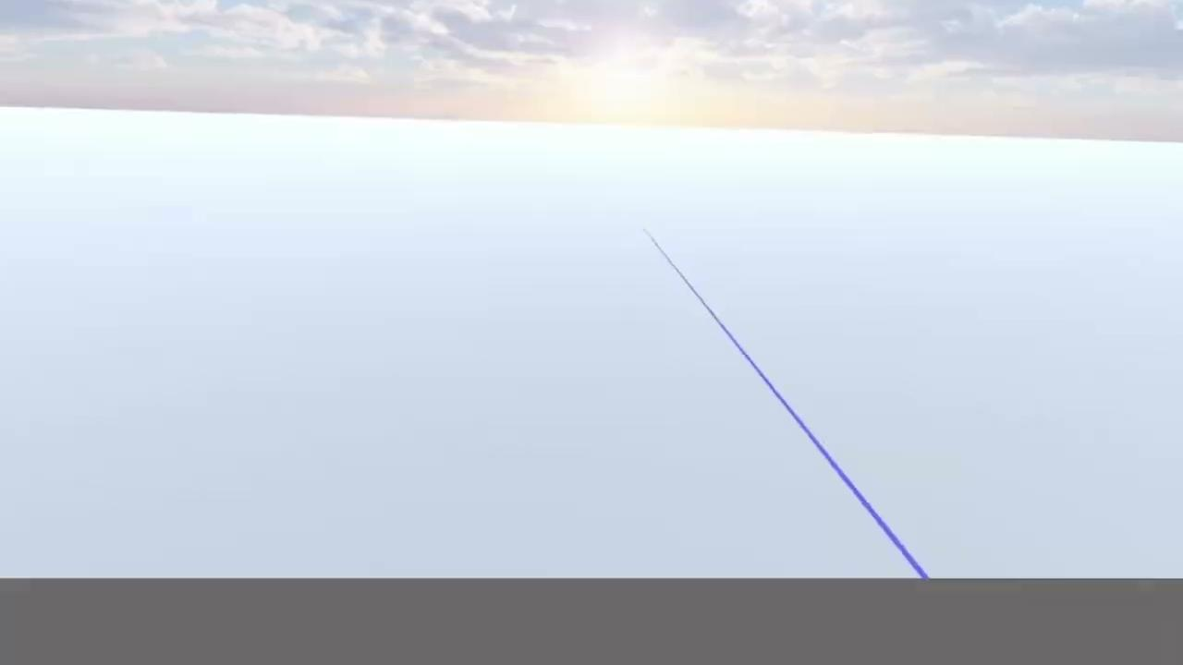

Slide 25
Project demo video
▶

Slide 26
The Bitter Lesson of
AI
MMI?
Handcrafted approaches will be outperformed by simpler, more general approaches leveraging increased compute.
http://www.incompleteideas.net/IncIdeas/BitterLesson.html

Slide 27
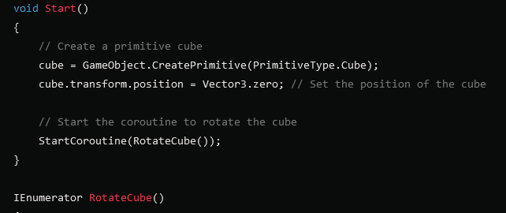
🔊 “Create a rotating cube”
GPT-4
GPT-5
GPT-6

Slide 28
Key Takeaways
• Language models have strong potential for use in MMIs,
when enhanced with tools like TTS, STT, Code Interp.
• MMIs should be built in a way that scales with compute
• Building general systems is more future proof compared to handcrafted solutions

Slide 29
Thank you for your attention!

Slide 30
Questions?

